Slide 1
STUDENT INFORMATION MANAGEMENT SYSTEM(SIMS) USING PHP
PROJECT MEMBERS
16104001 - ADITYA PAREEK.V
16104024 - DHINA.S
16104029 - GOBIPRASATH.N
GUIDE NAME
Mrs.J.Velumani,M.E.,
Asst.Professorfor

Slide 2
ABSTRACT
The creation and management of accurate, up-to-date information regarding a students’ academic career is critically important in the university as well as colleges. Student information system deals with all kind of student details, academic related reports, college details, course details, curriculum, batch details, placement details and other resource related details too. It will also have faculty details, batch execution details, students’ details in all aspects, the various academic notifications to the staff and students updated by the college administration.

Slide 3
REQUIREMENTS
SOFTWARE SPECIFICATION
Platform : Microsoft Windows
Front – End : PHP,CSS
Back – End : MySQL
Environment : XAMPP

Slide 4
LITERATURE SURVEY
Development of Student Information System
This research paper by N. M. Z. Hashim., S. N. K. S. Mohamed on the need to gather information about the students.It says that the focus of students data which can filter at for the placement requirements. It includes their activities with result tools.
Web Based Student Information Management System
This research paper by S.R.Bharamagoudar., Geeta R.B., S.G.Totad on the need to gather information about the students. It can be used by educational institutes or colleges to maintain the records of students easily. The creation and management of accurate, up-to-date information regarding a students’ academic career is critically important in the university as well as colleges.

Slide 5
DATA FLOW DIAGRAM
START
ADMIN HOME
TEACHER HOME
Login fails
LOGIN
LOGIN
Login Success
Login Success
STAFF
STUDENT
CGPA
STUDENT
CGPA

Slide 6
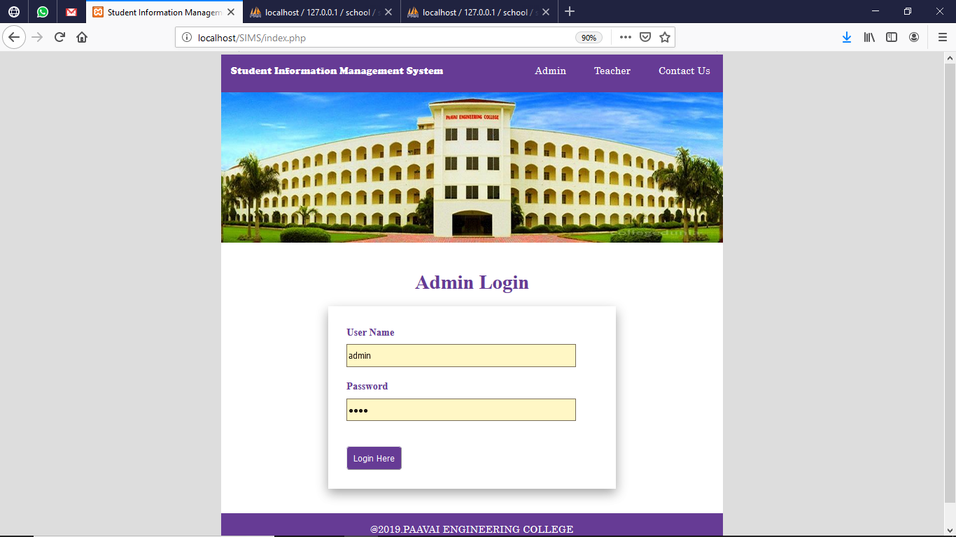
ADMIN LOGIN

Slide 7
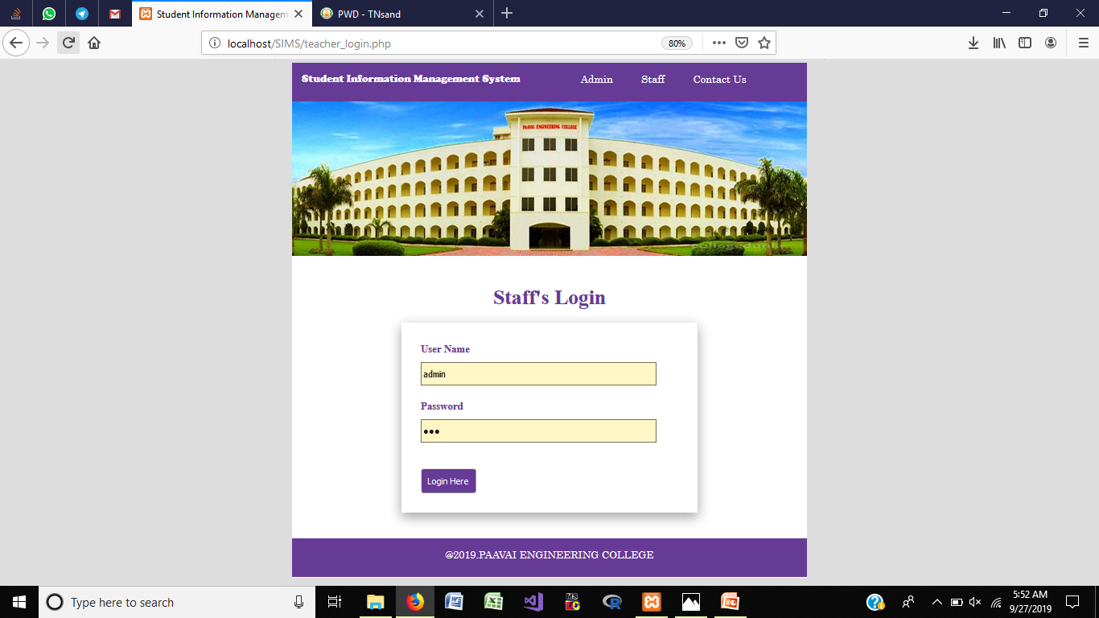
STAFF’S LOGIN

Slide 8
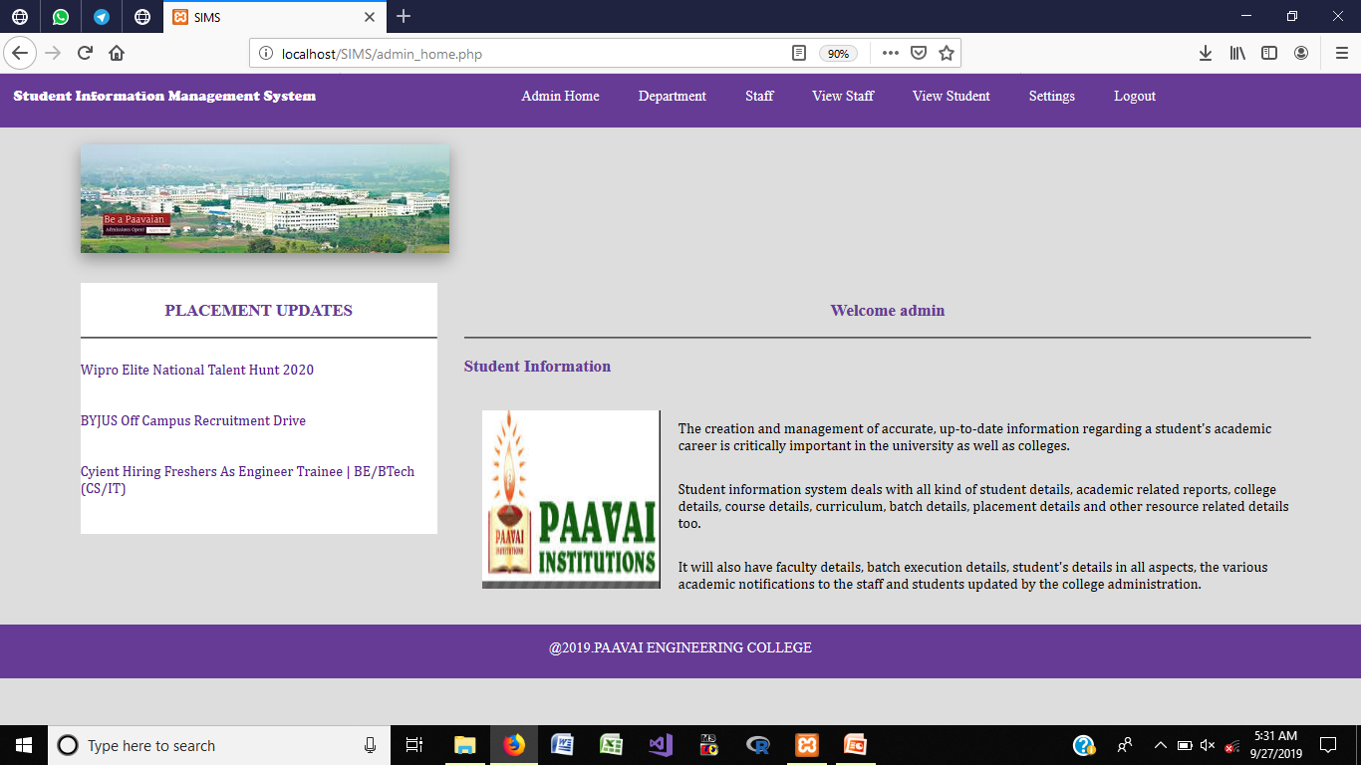
ADMIN HOME PAGE

Slide 9
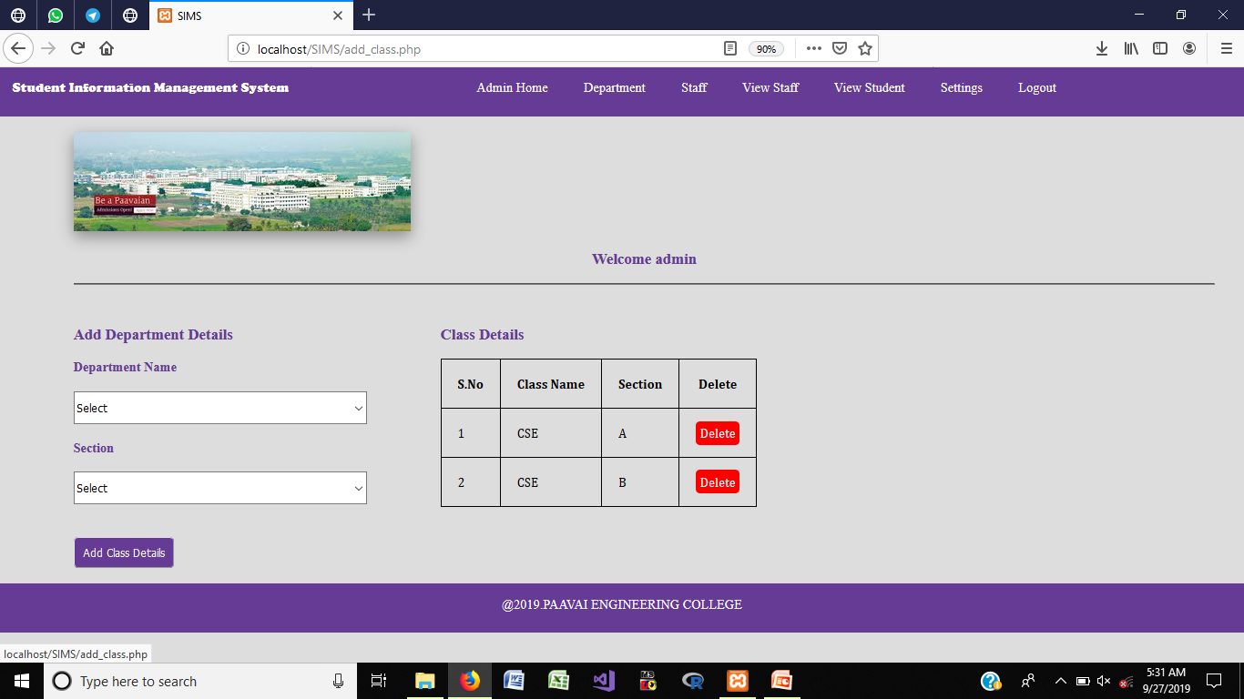
ADD DEPARTMENT

Slide 10
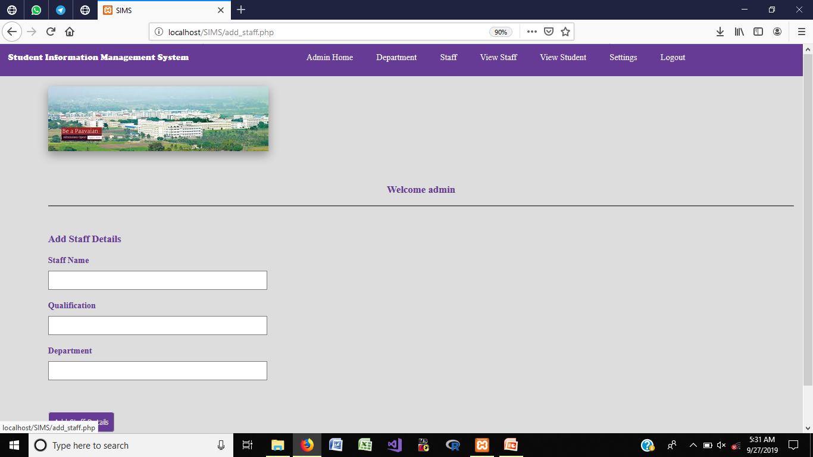
ADD STAFF DETAILS

Slide 11
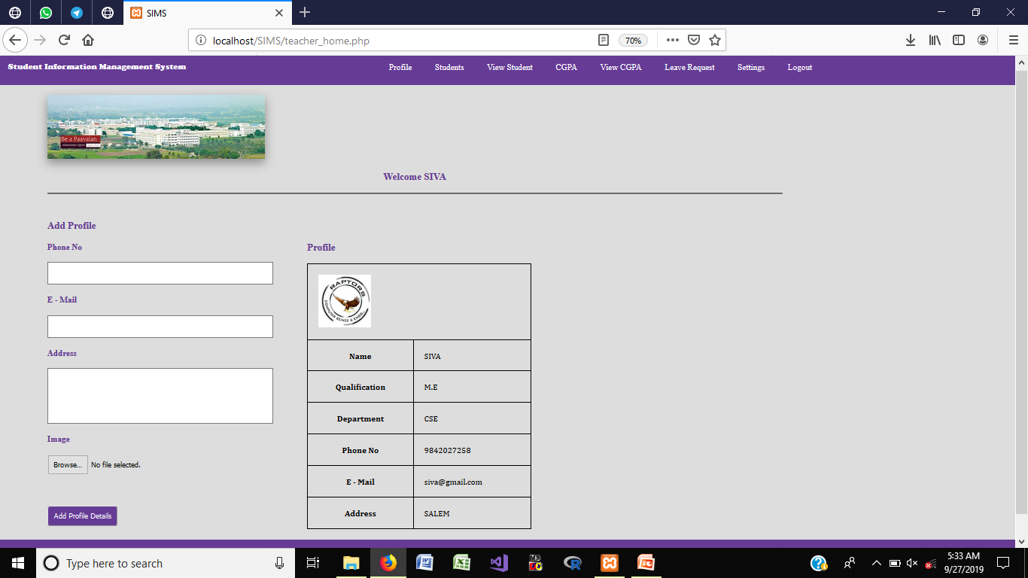
STAFF’S LOGIN - STAFF PROFILE

Slide 12
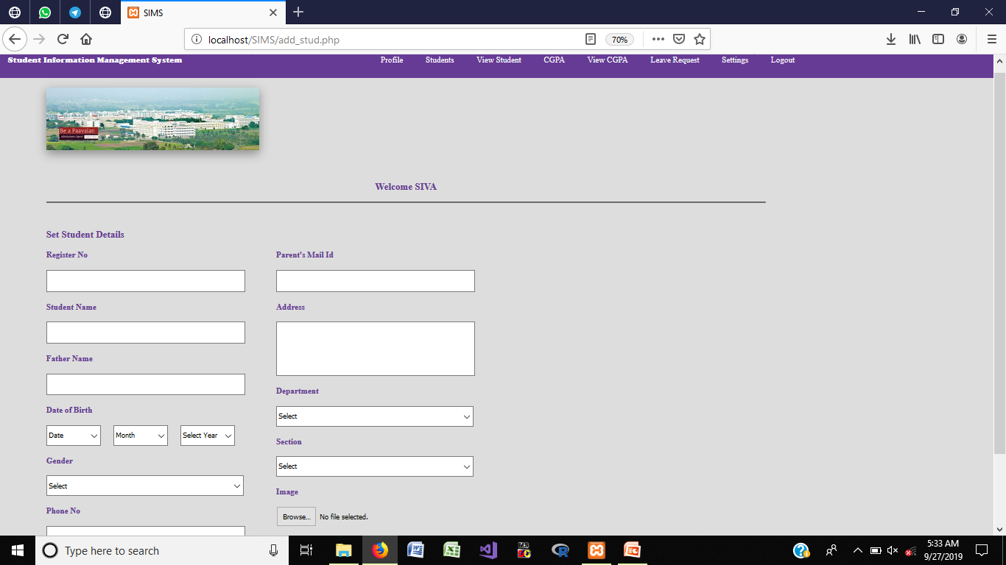
ADD STUDENTS DEATILS

Slide 13
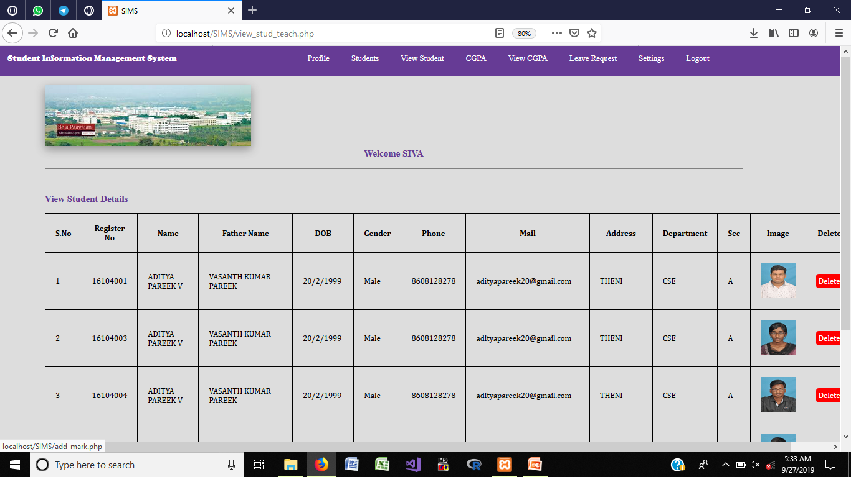
VIEW STUDENTS

Slide 14
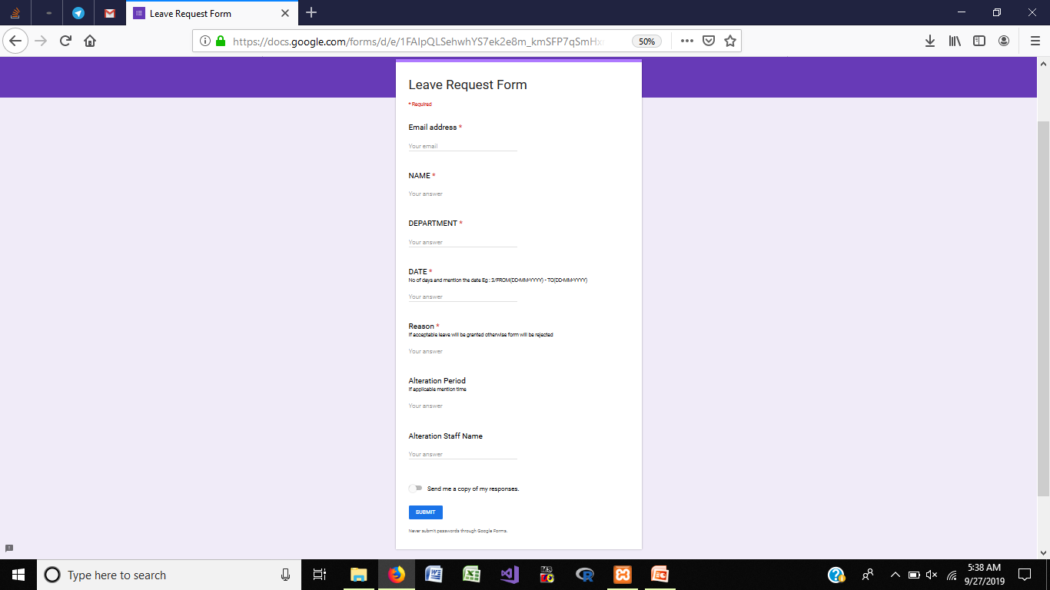
LEAVE REQUEST

Slide 15
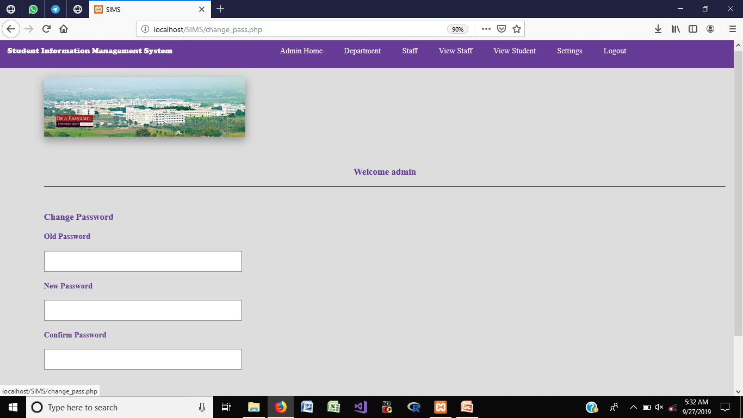
CHANGE PASSWORD

Slide 16
CONCLUSION
Can be accessed any time by using this system.
No wastage of resources in colleges and universities.
Monitored and controlled remotely.
Reduces the man power.
It provides accurate information always.

